Slide 1
Introduction (Instructor-Aman Ullah)
M. Sc. (Mathematics): 1987-89
Baha-ud-Din Zakariya University, Multan
M. Sc. (Computer Science): 1992-95
University of Engg. & Tech. Lahore
M. B. A. (MIS): 2006-08
Virtual University, Lahore
MS (Computer Science) (Gold Medal): 2008-10
Virtual University, Lahore

Slide 2
Introduction (CSC-102)
Discrete Structures

Slide 3
Introduction
It is a FUN Course

Slide 4
Introduction
It is a FUN Course
Many of the topics are fun, easy, and extremely useful to your education here in FCIT

Slide 5
Introduction
It is a FUN Course
Many of the topics are fun, easy, and extremely useful to your education here in FCIT
It is devoted towards the study of discrete objects

Slide 6
Introduction
It is a FUN Course
Many of the topics are fun, easy, and extremely useful to your education here in COMSATS
It is devoted towards the study of discrete objects
Integers (whole numbers), automobiles, houses, people, etc.

Slide 7
Introduction
Objects which are not discrete or Continuous

Slide 8
Introduction
Objects which are not discrete or Continuous
Real numbers are not discrete

Slide 9
Introduction
Objects which are not discrete or Continuous
Real numbers are not discrete
Between any two real numbers, there is an infinite number of additional real numbers

Slide 10
Introduction
Objects which are not discrete or Continuous
Real numbers are not discrete
Between any two real numbers, there is an infinite number of additional real numbers
So they are packed together, without any spaces

Slide 11
Introduction
Objects which are not discrete or Continuous
Real numbers are not discrete
Between any two real numbers, there is an infinite number of additional real numbers
So they are packed together, without any spaces
And they cannot be separated from their immediate neighbors

Slide 12
Introduction
Objects which are not discrete or Continuous
Real numbers are not discrete
Between any two real numbers, there is an infinite number of additional real numbers
So they are packed together, without any spaces
And they cannot be separated from their immediate neighbors
Therefore, they are not discrete

Slide 13
Introduction
Discrete means consisting of distinct or unconnected elements

Slide 14
Introduction
Discrete means consisting of separate, distinct, countable or unconnected elements/objects (like integers, graphs, logical statements)
Structures the arrangement of parts and relations between the parts of something complex

Slide 15
Introduction
Discrete Structures is mathematics that deals with discrete objects

Slide 16
Introduction
Discrete Structures is mathematics that deals with discrete objects
In this course, we will study several objects:

Slide 17
Introduction
Discrete Structures is mathematics that deals with discrete objects
In this course, we will study several objects:
Integers, Propositions, Sets, Relations, Functions etc.

Slide 18
Introduction
Discrete Structures is mathematics that deals with discrete objects
In this course, we will study several objects:
Integers, Propositions, Sets, Relations, Functions etc.
associated concepts, properties and relationships

Slide 19
Introduction
Problems Solved

Slide 20
Introduction
Problems Solved
probability of winning a raffle

Slide 21
Introduction
Problems Solved
probability of winning a raffle
ways to choose a valid password

Slide 22
Introduction
Problems Solved
probability of winning a raffle
ways to choose a valid password
shortest path between two cities

Slide 23
Introduction
Problems Solved
probability of winning a raffle
ways to choose a valid password
shortest path between two cities
possible valid Internet addresses
………………. etc.,

Slide 24
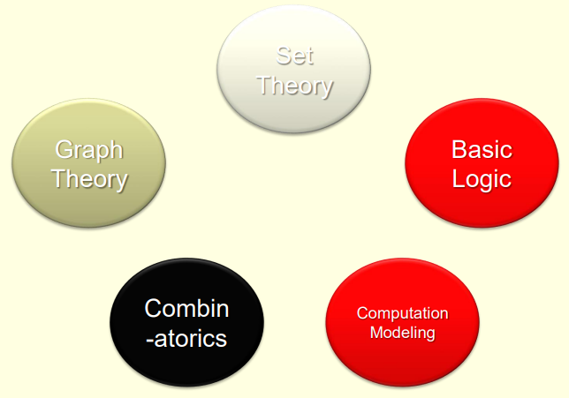
Introduction
What to study in CSC 102
Credits: Dr. Jonathan (Yahya) Cazalas & Dr. Muhammad Umair

Slide 25
Introduction
Database
Software Engg.
Networks
OS
Programming
Compiler
Graphics
Cryptography
What to study in CSC 102
Credits: Dr. Jonathan (Yahya) Cazalas & Dr. Muhammad Umair

Slide 26
Course Description
CSC – 102

Slide 27
Course Description
The primary goal of this course is to provide:

Slide 28
Course Description
The primary goal of this course is to provide:
An introduction to discrete structures for computer science.

Slide 29
Course Description
The primary goal of this course is to provide:
An introduction to discrete structures for computer science.
Discrete structures are the study of the logical and algebraic relationships between discrete objects.

Slide 30
Course Description
The primary goal of this course is to provide:
An introduction to discrete structures for computer science.
Discrete structures are the study of the logical and algebraic relationships between discrete objects.
The focus will be on logic and proofs, set theory, functions, relations, and counting techniques.

Slide 31
Motivation
CSC - 102

Slide 32
Course Description
Proofs

Slide 33
Course Description
Proofs
How do you prove something is correct?

Slide 34
Course Description
Proofs
How do you prove something is correct?
Maybe you are arguing with someone…

Slide 35
Course Description
Proofs
How do you prove something is correct?
Maybe you are arguing with someone…
How can you formulate (come up with) a logically sound (logically correct) proof, showing that you are correct?

Slide 36
Course Description
Proofs
How do you prove something is correct?
Maybe you are arguing with someone…
How can you formulate (come up with) a logically sound (logically correct) proof, showing that you are correct?
How do you know when something is not correct?

Slide 37
Course Description
Proofs
How do you prove something is correct?
Maybe you are arguing with someone…
How can you formulate (come up with) a logically sound (logically correct) proof, showing that you are correct?
How do you know when something is not correct?
Such as showing that 2=1 ?

Slide 38
Prove that 2 = 1
Let a and b be non-zero such that

Slide 39
Prove that 2 = 1
Let a and b be non-zero such that
a = b

Slide 40
Prove that 2 = 1
Let a and b be non-zero such that
a = b
Multiply both sides by a

Slide 41
Prove that 2 = 1
Let a and b be non-zero such that
a = b
Multiply both sides by a
a² = ab

Slide 42
Prove that 2 = 1
Let a and b be non-zero such that
a = b
Multiply both sides by a
a² = ab
Subtract b²

Slide 43
Prove that 2 = 1
Let a and b be non-zero such that
a = b
Multiply both sides by a
a² = ab
Subtract b²
a²-b² = ab-b²

Slide 44
Prove that 2 = 1
Let a and b be non-zero such that
a = b
Multiply both sides by a
a² = ab
Subtract b²
a²-b² = ab-b²
Factor both sides

Slide 45
Prove that 2 = 1
Let a and b be non-zero such that
a = b
Multiply both sides by a
a² = ab
Subtract b²
a²-b² = ab-b²
Factor both sides
(a-b)(a+b) = b(a-b)

Slide 46
Prove that 2 = 1
Divide by (a-b)

Slide 47
Prove that 2 = 1
Divide by (a-b)
a + b = b

Slide 48
Prove that 2 = 1
Divide by (a-b)
a + b = b
Since a = b, we replace a with b

Slide 49
Prove that 2 = 1
Divide by (a-b)
a + b = b
Since a = b, we replace a with b
b + b = b

Slide 50
Prove that 2 = 1
Divide by (a-b)
a + b = b
Since a = b, we replace a with b
b + b = b
Combine terms

Slide 51
Prove that 2 = 1
Divide by (a-b)
a + b = b
Since a = b, we replace a with b
b + b = b
Combine terms
2b = b

Slide 52
Prove that 2 = 1
Divide by (a-b)
a + b = b
Since a = b, we replace a with b
b + b = b
Combine terms
2b = b
As b is non-zero, divide it out

Slide 53
Prove that 2 = 1
Divide by (a-b)
a + b = b
Since a = b, we replace a with b
b + b = b
Combine terms
2b = b
As b is non-zero, divide it out
2 = 1

Slide 54
Prove that 2 = 1
Divide by (a-b)
a + b = b
Since a = b, we replace a with b
b + b = b
Combine terms
2b = b
As b is non-zero, divide it out
2 = 1

Slide 55
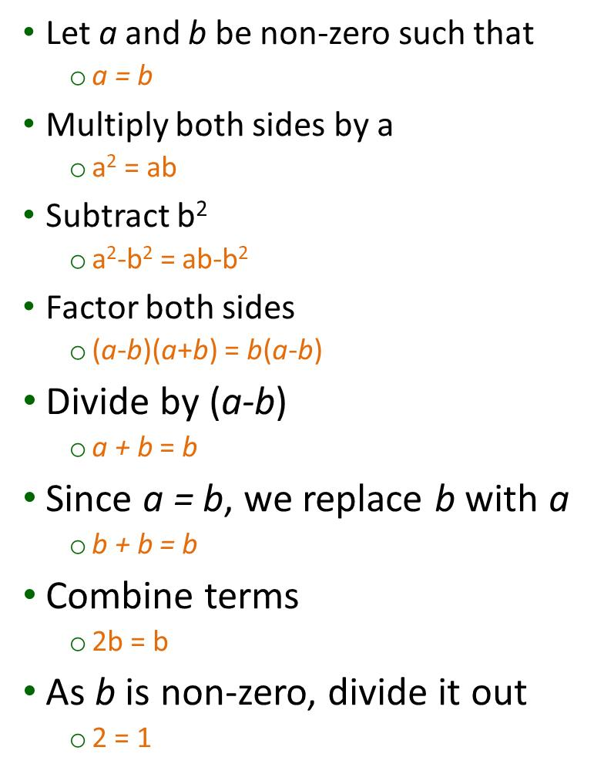
Prove that 2 = 1

Slide 56
Paradox
A paradox is a statement or situation that seems self-contradictory, logically impossible, or against common sense, yet it may reveal an underlying truth.
In logic and philosophy: A paradox arises when reasoning with apparently valid steps leads to a contradiction.
In everyday use: It describes something that "doesn't make sense at first glance" but provokes deeper thought.

Slide 57
Liar Paradox
“I always tell a lie”
TRUE FALSE

Slide 58
Liar Paradox (“I always tell a lie”)
🔹 Case 1: Suppose the person is telling the truth.
If the statement “I always tell a lie” is true,
That means the person always lies.
But in this case, he is telling the truth (about always lying).
Contradiction ❌.
🔹 Case 2: Suppose the person is lying.
Then the statement “I always tell a lie” is false.
That means the person speaks the truth.
Again, it contradicts itself ❌.

Slide 59
Course Description
Logical Thinking & Reasoning

Slide 60
Course Description
Logical Thinking & Reasoning
This is a MAJOR part of this course

Slide 61
Course Description
Logical Thinking & Reasoning
This is a MAJOR part of this course
Training your brain to use reason and logic to formulate/create sound (good) arguments

Slide 62
Course Description
Logical Thinking & Reasoning
This is a MAJOR part of this course
Training your brain to use reason and logic to formulate/create sound (good) arguments
The following slide shows an example of a problem

Slide 63
Course Description
Logical Thinking & Reasoning
This is a MAJOR part of this course
Training your brain to use reason and logic to formulate/create sound (good) arguments
The following slide shows an example of a problem
See if you can identify the mistake in the logic

Slide 64
Course Description
Logical Thinking & Reasoning

Slide 65
Course Description
Logical Thinking & Reasoning
Three people check into a hotel. They pay 300sr (total) to the manager, and then they go to their room. The manager suddenly remembers that the price for the room is only 250sr (meaning, the guests paid too much money). So he gives 50sr to a worker, and he tells the worker to return the 50sr to the people.

Slide 66
Course Description
Logical Thinking & Reasoning
Three people check into a hotel. They pay 300sr (total) to the manager, and then they go to their room. The manager suddenly remembers that the price for the room is only 250sr (meaning, the guests paid too much money). So he gives 50sr to a worker, and he tells the worker to return the 50sr to the people.
On the way to the room, the worker realizes that 50sr would be difficult to share among three people (50/3 does not divide evenly). So he decides to keep 20sr (puts it in his pocket!), and then he gives 10sr to each person.

Slide 67
Course Description
Logical Thinking & Reasoning
Three people check into a hotel. They pay 300sr (total) to the manager, and then they go to their room. The manager suddenly remembers that the price for the room is only 250sr (meaning, the guests paid too much money). So he gives 50sr to a worker, and he tells the worker to return the 50sr to the people.
On the way to the room, the worker realizes that 50sr would be difficult to share among three people (50/3 does not divide evenly). So he decides to keep 20sr (puts it in his pocket!), and then he gives 10sr to each person.
Now, each person paid 100sr and got back 10sr. So they paid 90sr each, totaling 270sr. The worker has 20sr in his pocket, totaling 290sr. Where is the missing 10sr?

Slide 68
Course Learning Outcomes (CLOs)
CPCS - 102

Slide 69
Course Learning Outcomes (CLO)
Find the truth value of propositions and compound propositions using truth tables.
Prove Propositional Equivalences.
Identify the truth value of quantifiers
Negate quantified expressions, nested or otherwise.
Identify the validity of arguments in Propositional logic and use Rules of Inference to build arguments.
Use direct proof, proof by contraposition, proof by contradiction, exhaustive proof and proof by cases to prove the validity of theorems.
SO-1
SO-1
SO-1
SO-1
SO-1
SO-1

Slide 70
Course Learning Outcomes (CLO)
Use set notation to express sets and represent sets graphically using Venn diagrams.
Calculate the union, intersection, complement, cardinality, power set, and Cartesian product of sets.
Determine the equality of sets using membership tables and set identities.
Determine the domain, co-domain, range, type, inverse, and composition of functions.
List and produce the terms of a sequence and find its formulae.
Express the sum of a sequence and compute its value.
SO-1
SO-1
SO-1
SO-1
SO-1
SO-1

Slide 71
Course Learning Outcomes (CLO)
Represent a relation using digraphs and matrices.
Analyze the properties and combinations of relations.
Find the inverse, complement, composition, and closure of a relation.
Apply the basic counting principles, the pigeonhole principle, permutations and combinations to solve counting problems.
Use mathematical induction, and strong induction to prove the validity of statements.
SO-1
SO-1
SO-1
SO-1
SO-1
SO-1

Slide 72
Course Information
CPCS - 102

Slide 73
Contact Details
Mr. Aman Ullah
Teaching Hours:
Mon & Wed 11:30 AM –01:00 PM
namanyz@yahoo.com

Slide 74
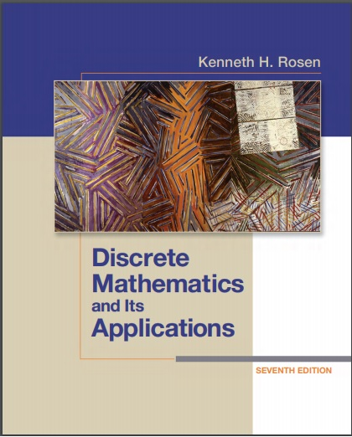
Text Book
Rosen, "Discrete Mathematics and Its Applications“
McGraw-Hill; 7th edition (2011).
ISBN-10: 0073383090
ISBN-13: 978-0073383095.

Slide 75
General Policies
Attendance must be 80% or more
All written exams will be cumulative
Quizzes will be during class, No Makeup
Plagiarism / cheating will result in -3% marks or even “F” grade may be awarded
Scale up / bonus for final grade TBD by the Coordinator of the course

Slide 76
Assessments
Assessment | Grading Percentage
Mid Term Exam | 25%
Final exam | 50%
Homeworks (4) | 15%
Quizzes (4) | 10%

Slide 77
Lectures Plan
CSC - 102

Slide 78
Week - 01
Introduction: Course Introduction, Course policies, Course contents, Assessment and Marks distribution.
Logic and Proofs: Propositional Logic, Introduction, Proposition, Truth Table, Conditional Statement, Converse, Contrapositive and Inverse, Examples

Slide 79
Week - 02
Logic and Proofs: Bi-conditional, Truth table and Compound Propositions, Precedence of Logical Operators, Examples
Applications of Propositional Logic: Introduction, Translating English sentences, System Specifications, Logical Puzzles & Circuits,

Slide 80
Week - 03
Propositional Equivalence: Introduction, Logical Equivalence, Usage of De Morgan’s Laws, Propositional Satisfiability, Application of Satisfiability, Solving Problems
Predicate and Quantifier: Introduction, Predicates, Quantifier, Quantifier with restricted Domains, Precedence of Quantifier

Slide 81
Week - 04
Predicate and Quantifier: Logical Equivalences involving Quantifier, Negating Quantified Expression, Translating from English into Logical Expression, System Specification

Slide 82
Week - 05
Nested Quantifier (NQ): Introduction, Understanding the statements involving NQ, Order of Quantifier, Mathematical Statements into NQ statements, NQ into English, NQ into English, English to Logical Exp., Negating NQ
Rules of Inference: Introduction, Valid Arguments in Propositional Logic, Its Rules, Rules to Build Arguments

Slide 83
Week – 06 - 07
Rules of Inference: Resolution, Fallacies, Rules for Quantified Statements, Combining Rules of Inference for Propositions and Quantified Statements
Proofs: Introduction, Basic Terminology, Theorems, Methods of proving theorems, Direct Proofs, Proof by Contraposition, By Contradiction,

Slide 84
Week - 08
Sets: Introduction, Venn Diagrams, Subsets, Power Sets, Cartesian Products, Set Notation with Quantifiers, Set Identities, Unions and Intersections
Functions: Introduction, One to One, Onto function, Inverse and Compositions of functions, Graph of function, Partial Function

Slide 85
Week - 09
Sequence and Summations: Introduction, Sequences, Geometric, Arithmetic, Recurrence Relations, Special Integer Sequences, Summations, Useful Summation Formulae

Slide 86
Week - 10
Functions: Introduction to functions, Terminologies related to functions, Some examples, Function representation, Types of function, One to One, Onto function, Bijection, Inverse and Compositions of functions, Graph of function, Standard Functions

Slide 87
Week - 10
Relations: Introduction, Functions as Relations, Relation on a set, Properties of Relations, Combining Relations
Representing Relations: Introduction, Using Matrices, Using Digraphs, Problem Solving

Slide 88
Week - 11
Equivalence Relations: Introduction, Equivalence Classes, Equivalence and Partitions

Slide 89
Week - 12
Basics of Counting: Introduction, Basic Counting Principles, Complex Counting problems, The Subtraction Rule, The Division Rule, Tree Diagrams
The Pigeonhole Principle: Introduction, Generalized Principle, Elegant Applications

Slide 90
Week - 13
Permutation-Combinations: Introduction, Definitions and its use, r-permutations, r-combinations, Combinatorial Proof, Problem Solving,

Slide 91
Week - 14
Mathematical Induction: Introduction, Validity, Good & Bad of Mathematical Induction, Examples of proofs by Mathematical Induction, Mistaken Proofs by Mathematical Induction, Guidelines for Proofs. Strong Induction: Introduction, Examples of Proofs by Strong Induction, Use of Strong Induction, Proofs Using Well-Ordering Property

Slide 92
Week - 15
Course Revision

Slide 93
Week – 16 - 18
Final Exam

